Slide 1
IS452: Week 1
Foundations of Information Processing

Slide 2
Who am I?
Dr. Nick LaLone,
Adjunct
Credentials:
PhD from Penn State - IST
Sociology Masters - Texas State
Assistant Professor @ Bellevue University

Slide 3
What is 452?
We’ll cover:
basics of programming in Python
core processing tools
Not all intro programming courses are the same
We expect you have never programmed before
Or thought about your computer in “that way”

Slide 4
What is 452?
This course is for beginners
Focus on data processing
Not just python
What isn’t covered?
Notes:
Data Processing Versus: games, large software engineering, data analytics
Omissions : object oriented design, scientific programming, pandas, graphical interfaces, games, etc.
We’ll cover:
basics of programming in Python
core processing tools
Not all intro programming courses are the same We expect you have never programmed before Or thought about your computer in “that way”

Slide 5
Why does this class exist?
So you can:
Recognize a programming problem
Assess how to tackle it
And be able to do it yourself
and know when it’s time to say no
Notes:
Maybe I’m the only one who keeps getting asked why the class I teach exists?
Because being able to directly interact with data and digital files is powerful and sometimes the only way to get the job done
As current/future information professionals, you know that data and digital formats are constantly changing. So you need to be prepared for anything.
Which means you need to be prepared to learn anything. This class isn’t to make you a Python dev, it’s to give you programming fundamentals so you can:

Slide 6
What do I need to know?
What will I be doing?

Slide 7
Expectations Before Starting
install programs
unzip and zip files
take screenshots
send emails with attachments
navigate your file system
how to use Blackboard Ultra
Notes:
Please find out how to:
Install programs
Unzip and zip files
Take screenshots
Send emails with attachments
Know how to navigate your file system, opening folders and moving around you directory, etc.
Be comfortable interacting in Blackboard Collaborate
Be able to share your screen in Blackboard

Slide 8
What do I need to do?
Weekly
Quizzes
Weekly homework
Irregularly
Research essays (2 of 3)
Midterm project
Final project
Notes:
Weekly quizzes
These are multiple choice questions based on the readings, and are designed for you to identify areas you need to review. You can take them up to three times (as needed).
Weekly homeworks
These will consist of problems found in the textbook and then later custom problems I’ve written and are described in moodle.
Midterm project:
A larger programming project (Dracula) you should be working on through the course of the first section of class and two short essays on programming topics.
Two (pick two of three) research essays
Three essay topics will be offered, so you can pick two to do or do all three for extra credit. These can be completed at any time before the due date, so something easy to work ahead on.
Final project
Proposals will be submitted just after midterms, which gives you 8 weeks to spread the work out.

Slide 9
More info on the assignments
Weekly quizzes
These are multiple choice questions based on the readings, and are designed for you to identify areas you need to review. You can take them up to three times (as needed).
Weekly homeworks
These will consist of problems found in the textbook and then later custom problems I’ve written and are described in moodle.
Midterm project:
A larger programming project (Dracula) you should be working on through the course of the first section of class and two short essays on programming topics.
Two (pick two of three) research essays
Three essay topics will be offered, so you can pick two to do or do all three for extra credit. These can be completed at any time before the due date, so something easy to work ahead on.
Final project
Proposals will be submitted just after midterms, which gives you 8 weeks to spread the work out.

Slide 10
Late and extension polices
Homework is due at 11:55pm,
before 8am is fine
may be turned in up to 2 days late
10% penalty for each day late.
3 extensions for an extra 5 days without penalty.
don’t need to explain why
Just email me that you need one before deadline

Slide 11
That’s a lot of homework
your grade is distributed.
plenty of extra credit
weighting and extra credit allow a buffer
If 100% on the other areas
at least a ~76% average on the weekly homework to keep your A.
Notes:
I respect that you have lives and other classes and a personal life
Your grade doesn’t depend on a single weekly homework assignment and there will be plenty of extra credit so you can keep your grade up even when things have gone poorly
I don’t expect that you’ll get 100% on every homework, so the weighting and extra credit allow a buffer for you to maintain an A even if you stumble on a few homework assignments.
Presuming that you can maintain 100% on the other areas, you just need to maintain at least a ~76% average on the weekly homework to keep your A. There’s plenty of extra credit to keep that score up.
But this does require a steady amount of time.

Slide 12
Moodle
You’re going to be a moodle pro after this class
Let’s do a tour and talk about where to find stuff

Slide 13
This class requires time
452 requires consistent work
Everything is doable!
You will survive
You will do well
You will learn a lot

Slide 14
Fiddly Bits!

Slide 15
How class normally works
lectures pre-written notes available via github repo.
You can, but aren’t required to, read the lecture notes before class.
I sometimes tweak notes just before class
I live code everything
demonstrating things live based on those lecture notes.
don’t use your time trying to desperately copy everything I type.
Listen, observe, make the connections.

Slide 16
Backboard ground rules
keep the side chatter in the chat to a minimum,
but feel free to interrupt with questions.
keep a running list of questions about things you hope I'll get to.
Ask those when I open the floor.
When we start digging in more I'll have polls for class questions.
Notes:
Question tips:
go for specific questions about the topic at hand.
keep a running list of questions about things you hope I'll get to. Ask those when I open the floor.
This seems a little cruel, but it keeps things on pace. Constantly reading questions and replying "We'll be talking about that soon" eats away at the little class time we have.
Feel free to email me things you'll hope we cover in class or other types of questions.
When we start digging in more I'll have polls for class questions.

Slide 17
Participation and attendance
participate during class and online in discussion boards.
there will be discussion prompts each week to help start a conversation – if needed.
If you will be missing class, please let me know before class.

Slide 18
Communication and asking questions
Administrative questions (E-Mail)
Just about you
About the entire class (Discussion Board)
Will open with admin updates and reminders
Content questions (Discussion Board)
Don’t post your solutions!

Slide 19
Buddies!
You’re working online but it’s good to have a buddy or two to work with.
Find someone in class that you can email or collaborate with!

Slide 20
Suggestions for success
Start early!
Do a little every day
The readings will help but…
…read homework first
Do not fear
the word stupid is forbidden in reference to yourself
…but you’re free to let Python have it
Notes:
Start early!
steady amount of time each day
The readings will help you.
Read the homework before the reading. This helps you know where to focus your reading and flag relevant examples.
Do not fear the math. Several of the chapters are very math heavy in examples, but I’ve selected homework problems that should not require advanced math ability to complete. I’ll also provide some clarifications in the assignment moodle page.
I forbid you to use the word stupid about any human in this room
But you’re free to let Python have it

Slide 21
The 2-Hour Rule
If you’ve been working for 2 hours without much success:
Get up and walk away.
Notes:
Also, if you do not understand based on my explanation or demonstration via video, you might not ever get it from my video alone. Do not be afraid to ask!

Slide 22
Learning Strategies for Technical Skills,
Or: learning how to learn programming

Slide 23
Less why; more how
We spend a lot of time talking about:
Reading
Grants
Publications
So much support for the essential scholarly work, but little prep for learning tech things.

Slide 24
When we say that programming is hard
We mean that it requires effort
will have to think hard
but you should experience hardship
Anxiety should be normal when learning
but never expected
It shouldn’t make an instructor feel good

Slide 25
But this seems harder than it should be
And you’re right
Most of us (including me) aren't from a computer science or STEM background
But most materials and instructors expect this, thus there's a lot of disconnect
“You mean you don’t like physics puzzles?”
Their expectations for a baseline are not our actual baseline

Slide 26
Specialization
Each of us has specialized learning skills
Going through graduate programs solidifies those skills and perspectives even more
Discomfort in not knowing
In Sociology there is no real right answer.
We come to a conclusion and justify it.
Disagreement appears!
Discussion over Correctness

Slide 27
Until we move into foreign domains
We lacking experience to learn efficiently
We are used to being efficient.
Source of frustration
The Black Box Appears!
A Stranger Appears!

Slide 28
We forget we had to learn how to learn
Do you remember learning how to read? to write?
How long did it take to become an expert?
The consequences of going native.
We forget what it was like as we move further from the space where we started to learn

Slide 29
How do humanities skills fit into writing code?

Slide 30
Programs as research papers
What are you writing?
Short, to the point
Single task
Make this into that
Long, lots of dependencies
Making a nuanced point
handles lots of options, problems, threads, etc.

Slide 31
Iteration
Writing a paper requires:
a thesis statement
doing some research
finding supportive evidence
making your point

Slide 32
Iteration
Writing a program requires
defining a problem to solve
doing some research
finding supportive frameworks and tools
making your deliverable

Slide 33
Neither is written from start to finish
We outline, develop, reevaluate, and trash
Sometimes we need to kill it with fire
Think of errors as writing group partners
Sure, sometimes you’ll end up with a jerk
But the critical feedback is why you’re there

Slide 34
Critical feedback is your friend
Success comes through failures
Take time to reflect on them so you learn and improve
Failure doesn’t have to be a four letter word
Embrace revisions
It's still hard to take criticism, but we accept that it is necessary, grit our teeth, and slog through
Error messages are no different
They are not the universe casting judgement on your soul and finding you wanting
They're a slightly impersonal method of the computer being confused

Slide 35
Debugging as spell checking
Proofreading
Error is reported--go find it
Look at your spelling
Check your punctuation balance
Check your containers and whitespace
Make sure you said what you meant to say

Slide 36
Debugging as spell checking
Debugging
Error is reported--go find it
Look at your spelling
Check your punctuation balance
Check your containers and whitespace
Make sure you said what you meant to say

Slide 37
Be okay not knowing the road you’ll travel
You will find the road
You will make it to the other side
Impossible to know exactly how to get there without stepping a foot out the door
So you want to write a poem…
Do you know how it’ll end when you start it?
Should you?
This idea of prescriptive solutions is both dishonest and not correct

Slide 38
Necessary uncertainty
Simple battle plan:
Receive input
Do magic
Profit

Slide 39
Necessary uncertainty
Data battle plan
Read in the data somehow
Investigate what it needs
Somehow do what it needs
Produce glorious outputs somehow

Slide 40
Archival research
Who here has done research in the archives?
one specific shiny thing
Most of the time you know it is in there somewhere
So you visit to sort out where it is and collect it into a useful format
‘browsing’ also happens in writing code

Slide 41
Enough of this
Questions?
A Tour of PyCharm?
What is Python? Can we do that?

Slide 42
Installation
The link is in the moodle.
Carefully and completely follow the directions.
Nothing in there is optional, nothing in there is because I think that writing directions is fun
We’ll be using:
Anaconda
which will install python for you
PyCharm Education Edition
which will be the environment where you will write and run python

Slide 43
OK, that was the hard sell on approaches toward getting stuff done, let's shift to more tangible details

Slide 44
Taking notes
What you're learning about isn't linear, so think outside the linear piece of paper
There are certainly linear aspects, but there's nothing linear about "first we learn about hair colors, then vegetable names, then about cars, then geography." in languages
When you take notes, focus on capturing the concepts and patterns
It's easier to fill in or look up a missing piece of syntax than it is a missing concept.

Slide 45
Taking notes
Be comfortable not knowing the full score as you’re moving forward
I know it can be hard, but really just turn that page and move forward
You’ll want to revisit things and add clarification as we build up our knowledge
Consider using a mind mapping program or drawing your notes in clusters

Slide 46
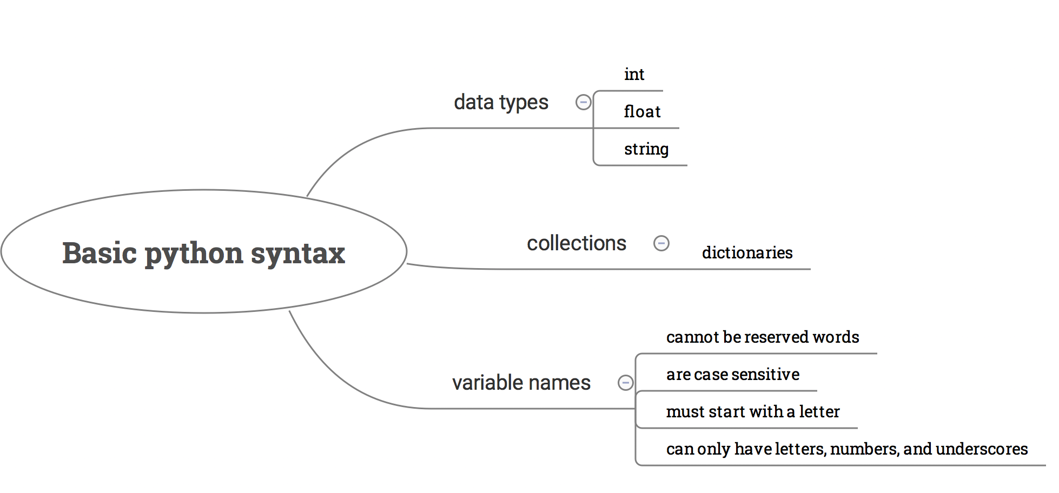
Taking notes

Slide 47
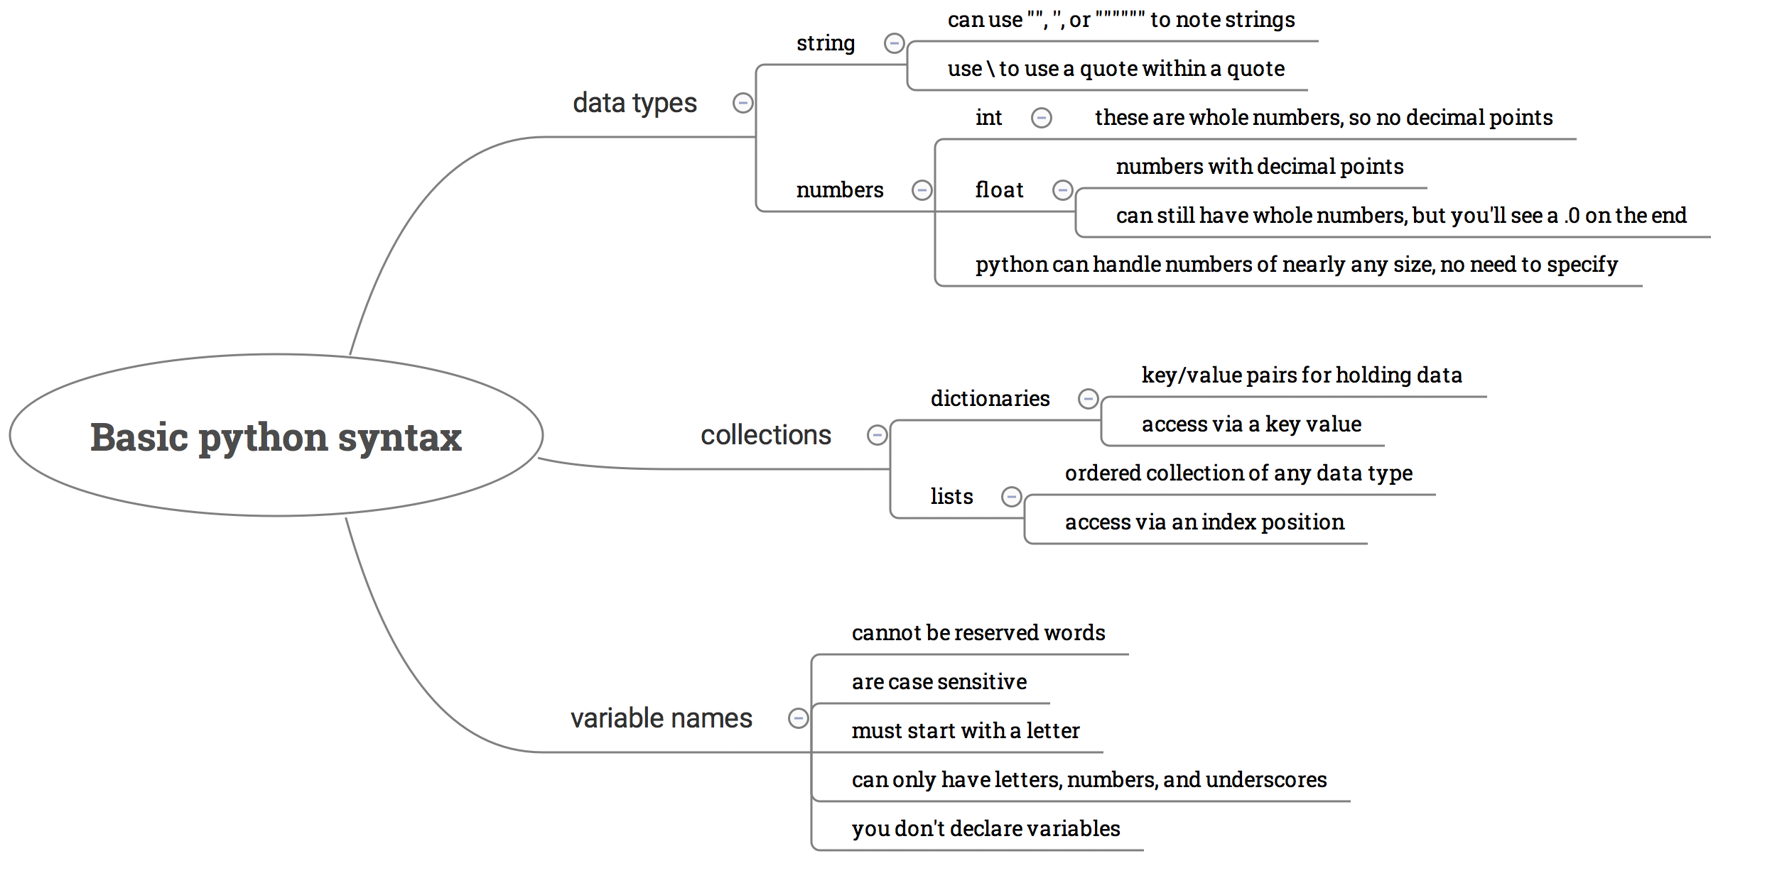
Taking notes

